Slide 1

Punctuation Primer

Slide 2

Let’s eat, grandma.
Let’s eat grandma.

Slide 3
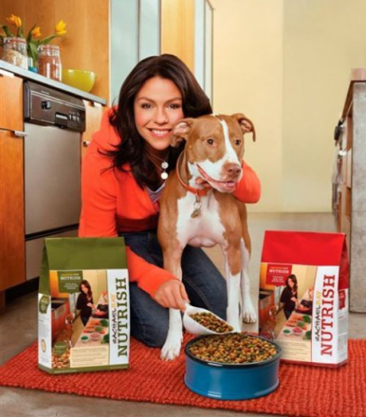
Rachael Ray finds inspiration in cooking her family and her dog.
Rachael Ray finds inspiration in cooking, her family, and her dog.

Slide 4
Why is punctuation important?
Missing or extra punctuation can create confusion.
Incorrect punctuation can create embarrassing gaffes.
Using punctuation effectively ensures your meaning is clear.

Slide 5
Overview
Periods, Exclamation Marks, and Question Marks
Commas
Dashes
Colons
Semicolons
Parentheses
Brackets
Quote Marks

Slide 6
Ending a Sentence

Slide 7
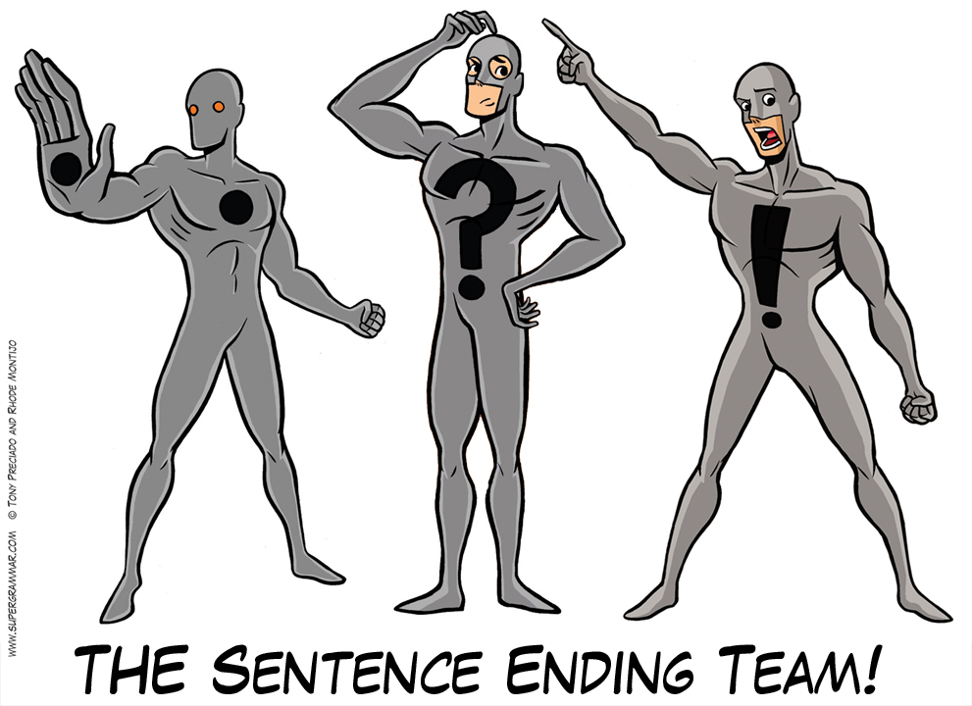
Options
Period
Question marks
Exclamation marks

Slide 8
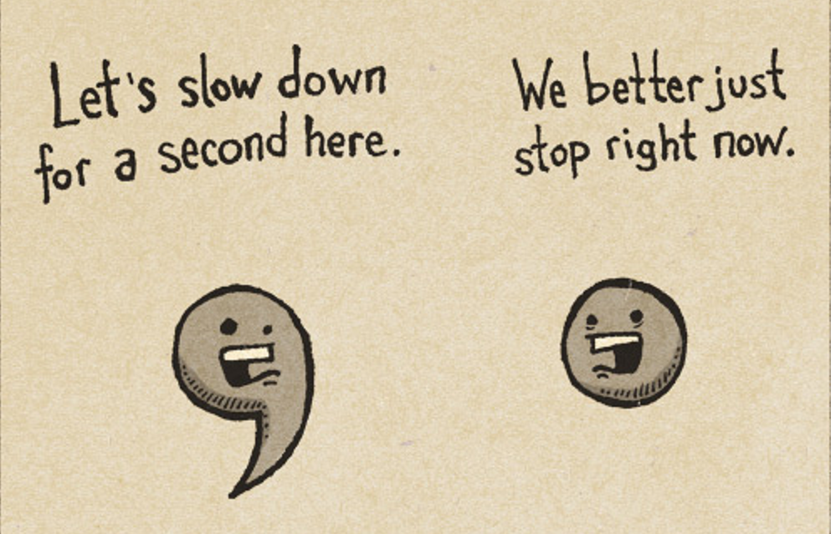
Periods
This is the most common way to end a sentence.
In academic writing, it is generally the most appropriate way to end a sentence.

Slide 9
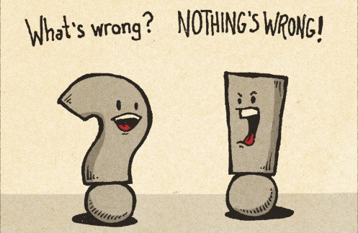
Question Marks
They can suggest what will be discussed in an essay.
Can effectively engage readers.
Used for proposed research questions.

Slide 10
Counterpoint
Question Marks?
Rhetorical questions are written in second person.
Thus, they may be considered informal.

Slide 11

Exclamation Marks
Exclamation marks denote emphasis and often imply a heightened emotional tone.
In academic writing, evoking an emotional tone raises questions about your partiality.

Slide 12
Commas

Slide 13
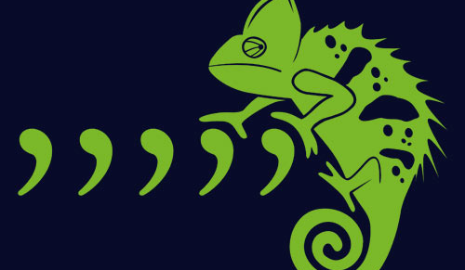
Applications
Linking independent clauses with a conjunction
Closing out an introductory element
Offsetting parenthetical information
Introduce coordinate elements at the end of a sentence
Offset dates and locations
Offset three or more items in a list

Slide 14
Linking Independent Clauses

Slide 15
Compound Sentences
When linking 2 independent clauses, the second clause will be introduced with a comma and a coordinating conjunction.

Slide 16
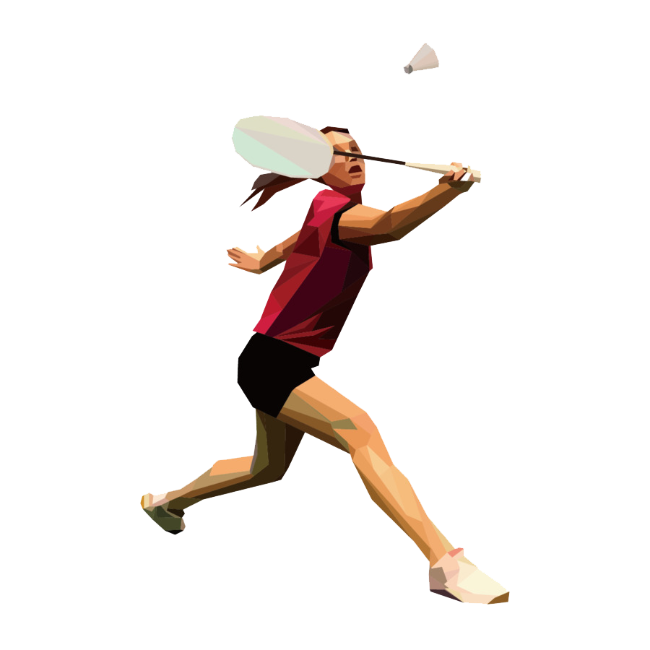
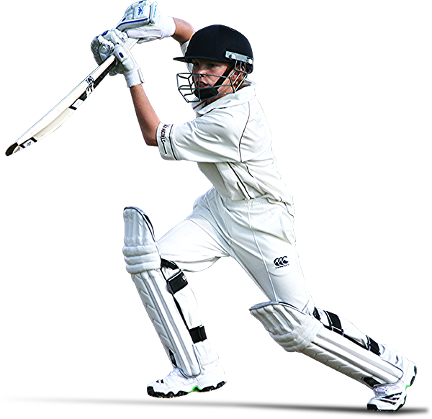
Example: Adding Independent Clauses
Raj likes cricket.
Tian likes badminton.

Slide 17
Example: Adding Independent Clauses
Raj likes cricket, and Tian likes badminton.

Slide 18
Note
When introducing a clause with a subordinating conjunction, there will be no comma.

Slide 19
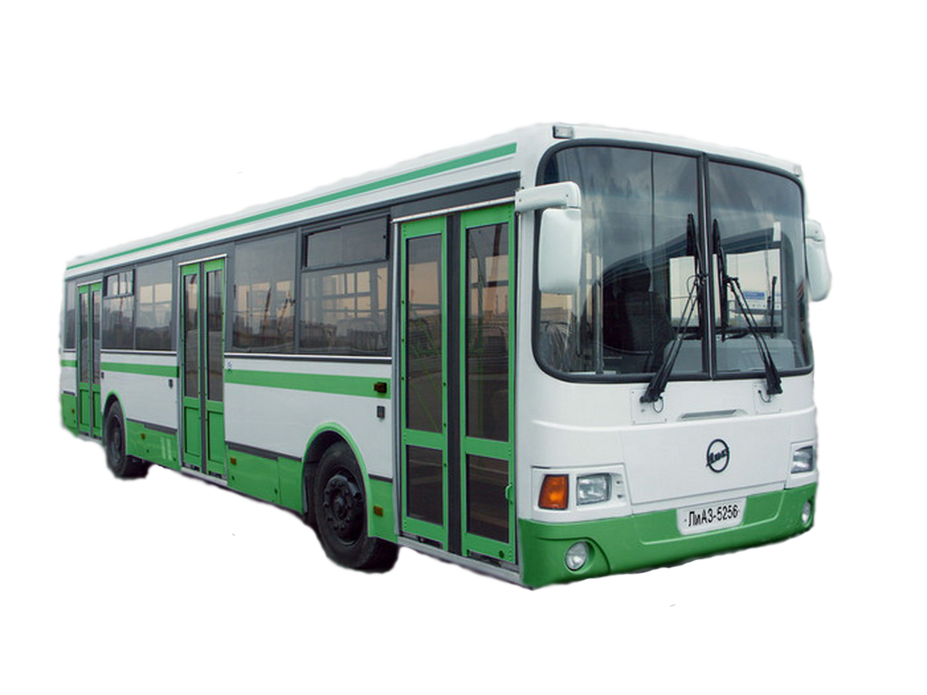

Example
I was late for class because the bus was running late.

Slide 20
Example
I was late for class because the bus was running late.

Slide 21

Example
I was late for class because the bus was running late.

Slide 22

How can you tell the difference?
Switch the clauses and watch where the conjunction goes.

Slide 23
Explanation
Coordinating conjunctions stay in the middle of the sentence.
Subordinating conjunctions follow the subordinate clause to the beginning of the sentence.

Slide 24
Raj likes cricket, and Tian likes badminton.
Tian likes badminton, and Raj likes cricket.

Slide 25
I was late for class because the bus was running late.
Because the bus was running late, I was late for class.

Slide 26
Introductory Elements
Adverbs
Adverbial phrase
Phrases
Clauses

Slide 27
What are transitional words/phrases/clauses?
ESTABLISH TIME OR LOCATION
Define a source
Provide context

Slide 28

Example: Context
I love Star Wars. However, I’m not sure I liked Rise of Skywalker.

Slide 29
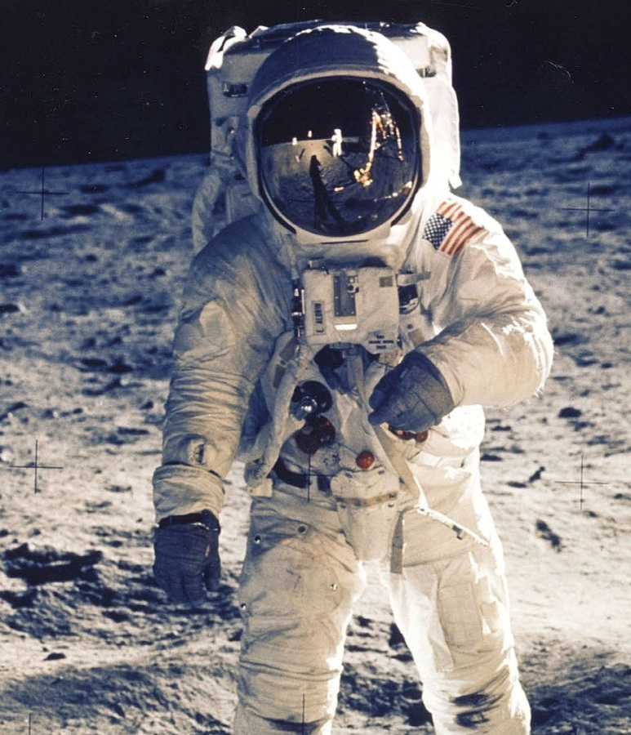
Examples: Sources
According to Buzz Aldrin, astronauts must declare moon rocks at customs.

Slide 30
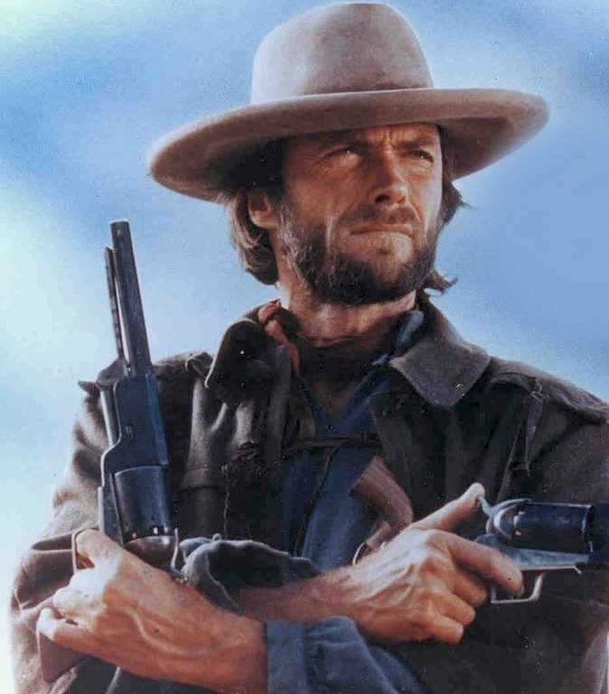
Examples: Time
At high noon, Regan is meeting Clint Eastwood.
NOTE: Prepositional phrases begin with a preposition.

Slide 31
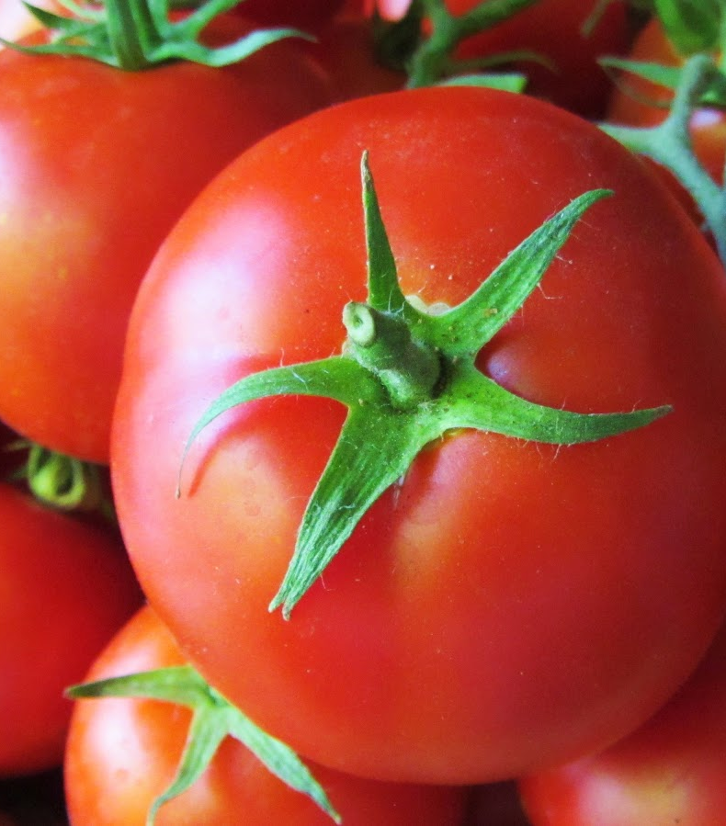
Examples: Location
In Leamington, Justin bought tomatoes.

Slide 32

Examples: Context
If at first you don’t succeed, skydiving is not for you!
NOTE: Introductory clauses begin with a conjunction.

Slide 33
How can you tell where the comma goes?
Look for the subject of the sentence. The comma usually comes before that.

Slide 34
Examples
At high noon, Regan is meeting Clint Eastwood.
In Leamington, Justin bought tomatoes.
According to Trump, wind turbines cause cancer.
If at first you don’t succeed, skydiving is not for you!

Slide 35
Parenthetical Information

Slide 36

What is Parenthetical Information?
When writing, we sometimes add non-essential information to enhance clarity or provide context.

Slide 37
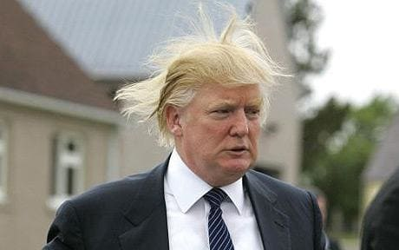
Donald Trump won the electoral college.
Donald Trump asserts that he is more humble than you could possibly imagine.
Donald Trump, who asserts that he is more humble than you could possibly imagine, won the electoral college.

Slide 38


Example: Parentheses vs. Commas
Donald Trump (who asserts that he is more humble than you could possibly imagine), won the electoral college.
Donald Trump, who asserts that he is more humble than you could possibly imagine, won the electoral college.

Slide 39
Coordinate Elements

Slide 40

What is a coordinate element
A coordinate element is a dependent clause/element that provides additional facts that provides context or contrasts the main clause.
The comma signals that this element shares the same grammatical context.

Slide 41
Combining Two Sentences
Jenny McCarthy and Jim Carrey are…
…celebrities.
…not medical professionals.

Slide 42
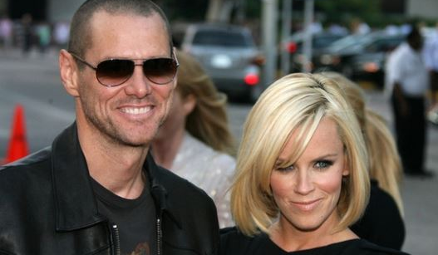
Example
Jenny McCarthy and Jim Carey are celebrities, not medical professionals.

Slide 43
Dates and Locations

Slide 44

Commas, Dates, and Locations
When pairing information regarding dates or locations, it is important to offset the information with a comma.

Slide 45

Example: Date
On November 5th, 1605, Guy Fawkes failed to enact the Gunpowder Plot.

Slide 46
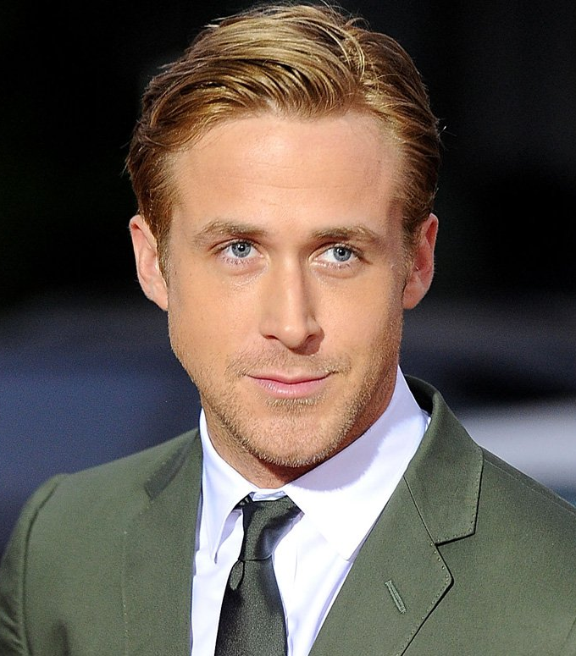
Example: Location
Ryan Gosling was born in London, Ontario.

Slide 47
Lists

Slide 48

Itemizing Lists
When listing three or more items, each additional item should be introduced with a comma.

Slide 49
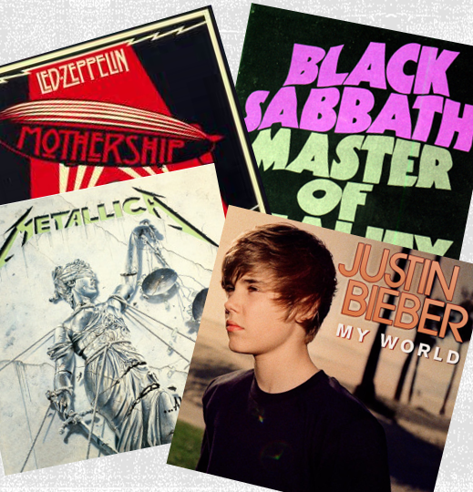
Example
I went to the record store and bought albums by Led Zeppelin, Black Sabbath, Metallica, and Justin Bieber.

Slide 50
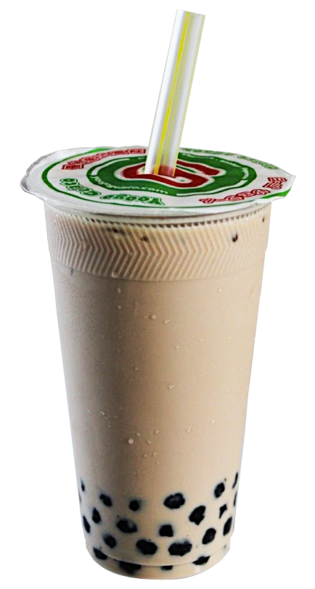
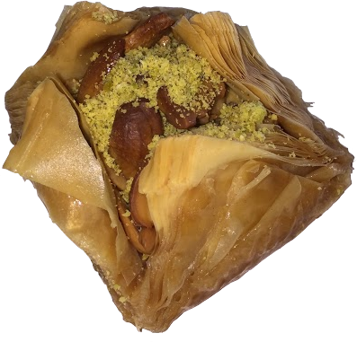
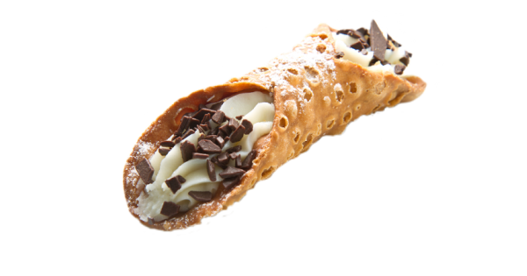
Oxford Comma
I like cannoli, baklava, and bubble tea.
I like cannoli, baklava and bubble tea.

Slide 51
Oxford Comma
I like cannoli, baklava, and bubble tea.
I like cannoli, baklava and bubble tea.

Slide 52

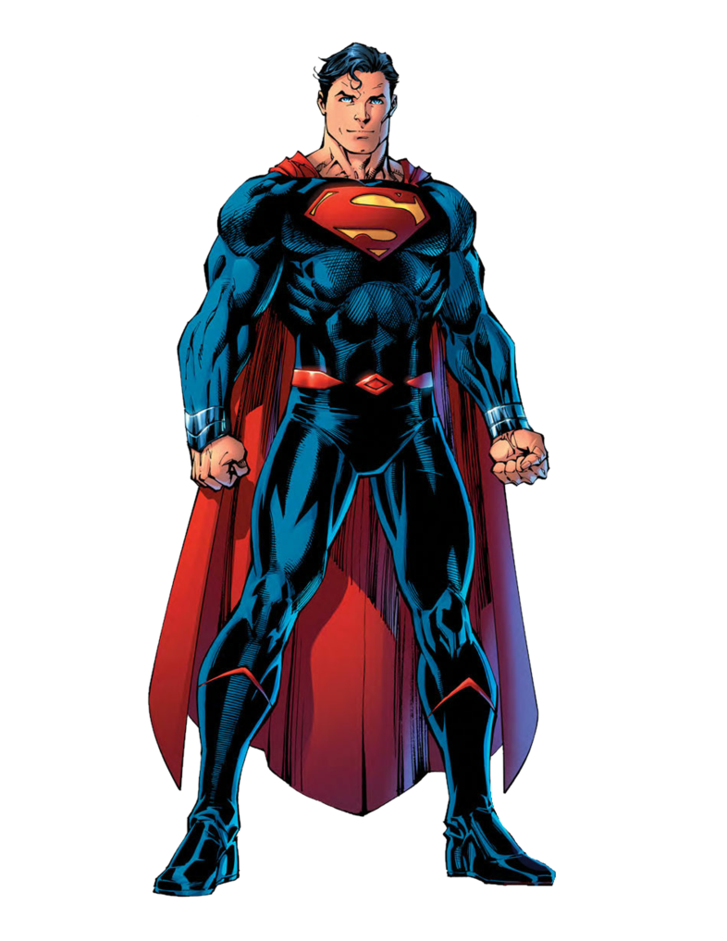
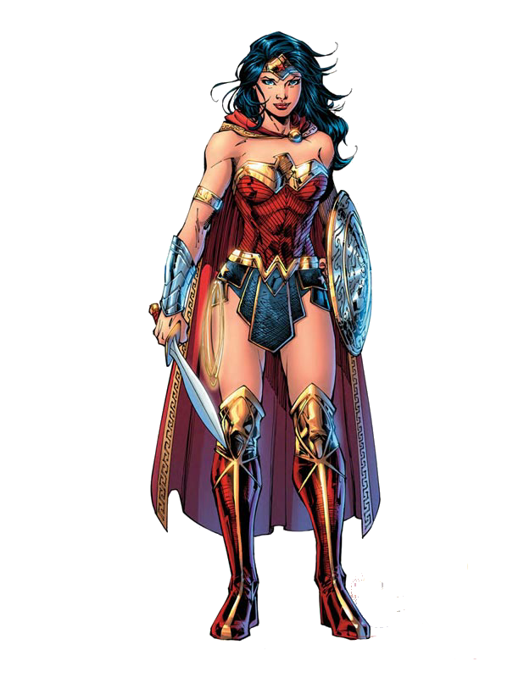
Confusion?
With
Without
The most influential people in my life are my parents, Wonder Woman, and Superman.
The most influential people in my life are my parents, Wonder Woman and Superman.

Slide 53


Slide 54
Colons and Semicolons

Slide 55
Colons

Slide 56

When can we use a colon?
Only after an independent clause.

Slide 57
Examples
We looked at: nationality, age, and gender.
We looked at nationality, age, and gender.
We looked at three social markers: nationality, age, and gender.

Slide 58
What are colons used for?
Lists
Conclusions
Summations
Appositives

Slide 59
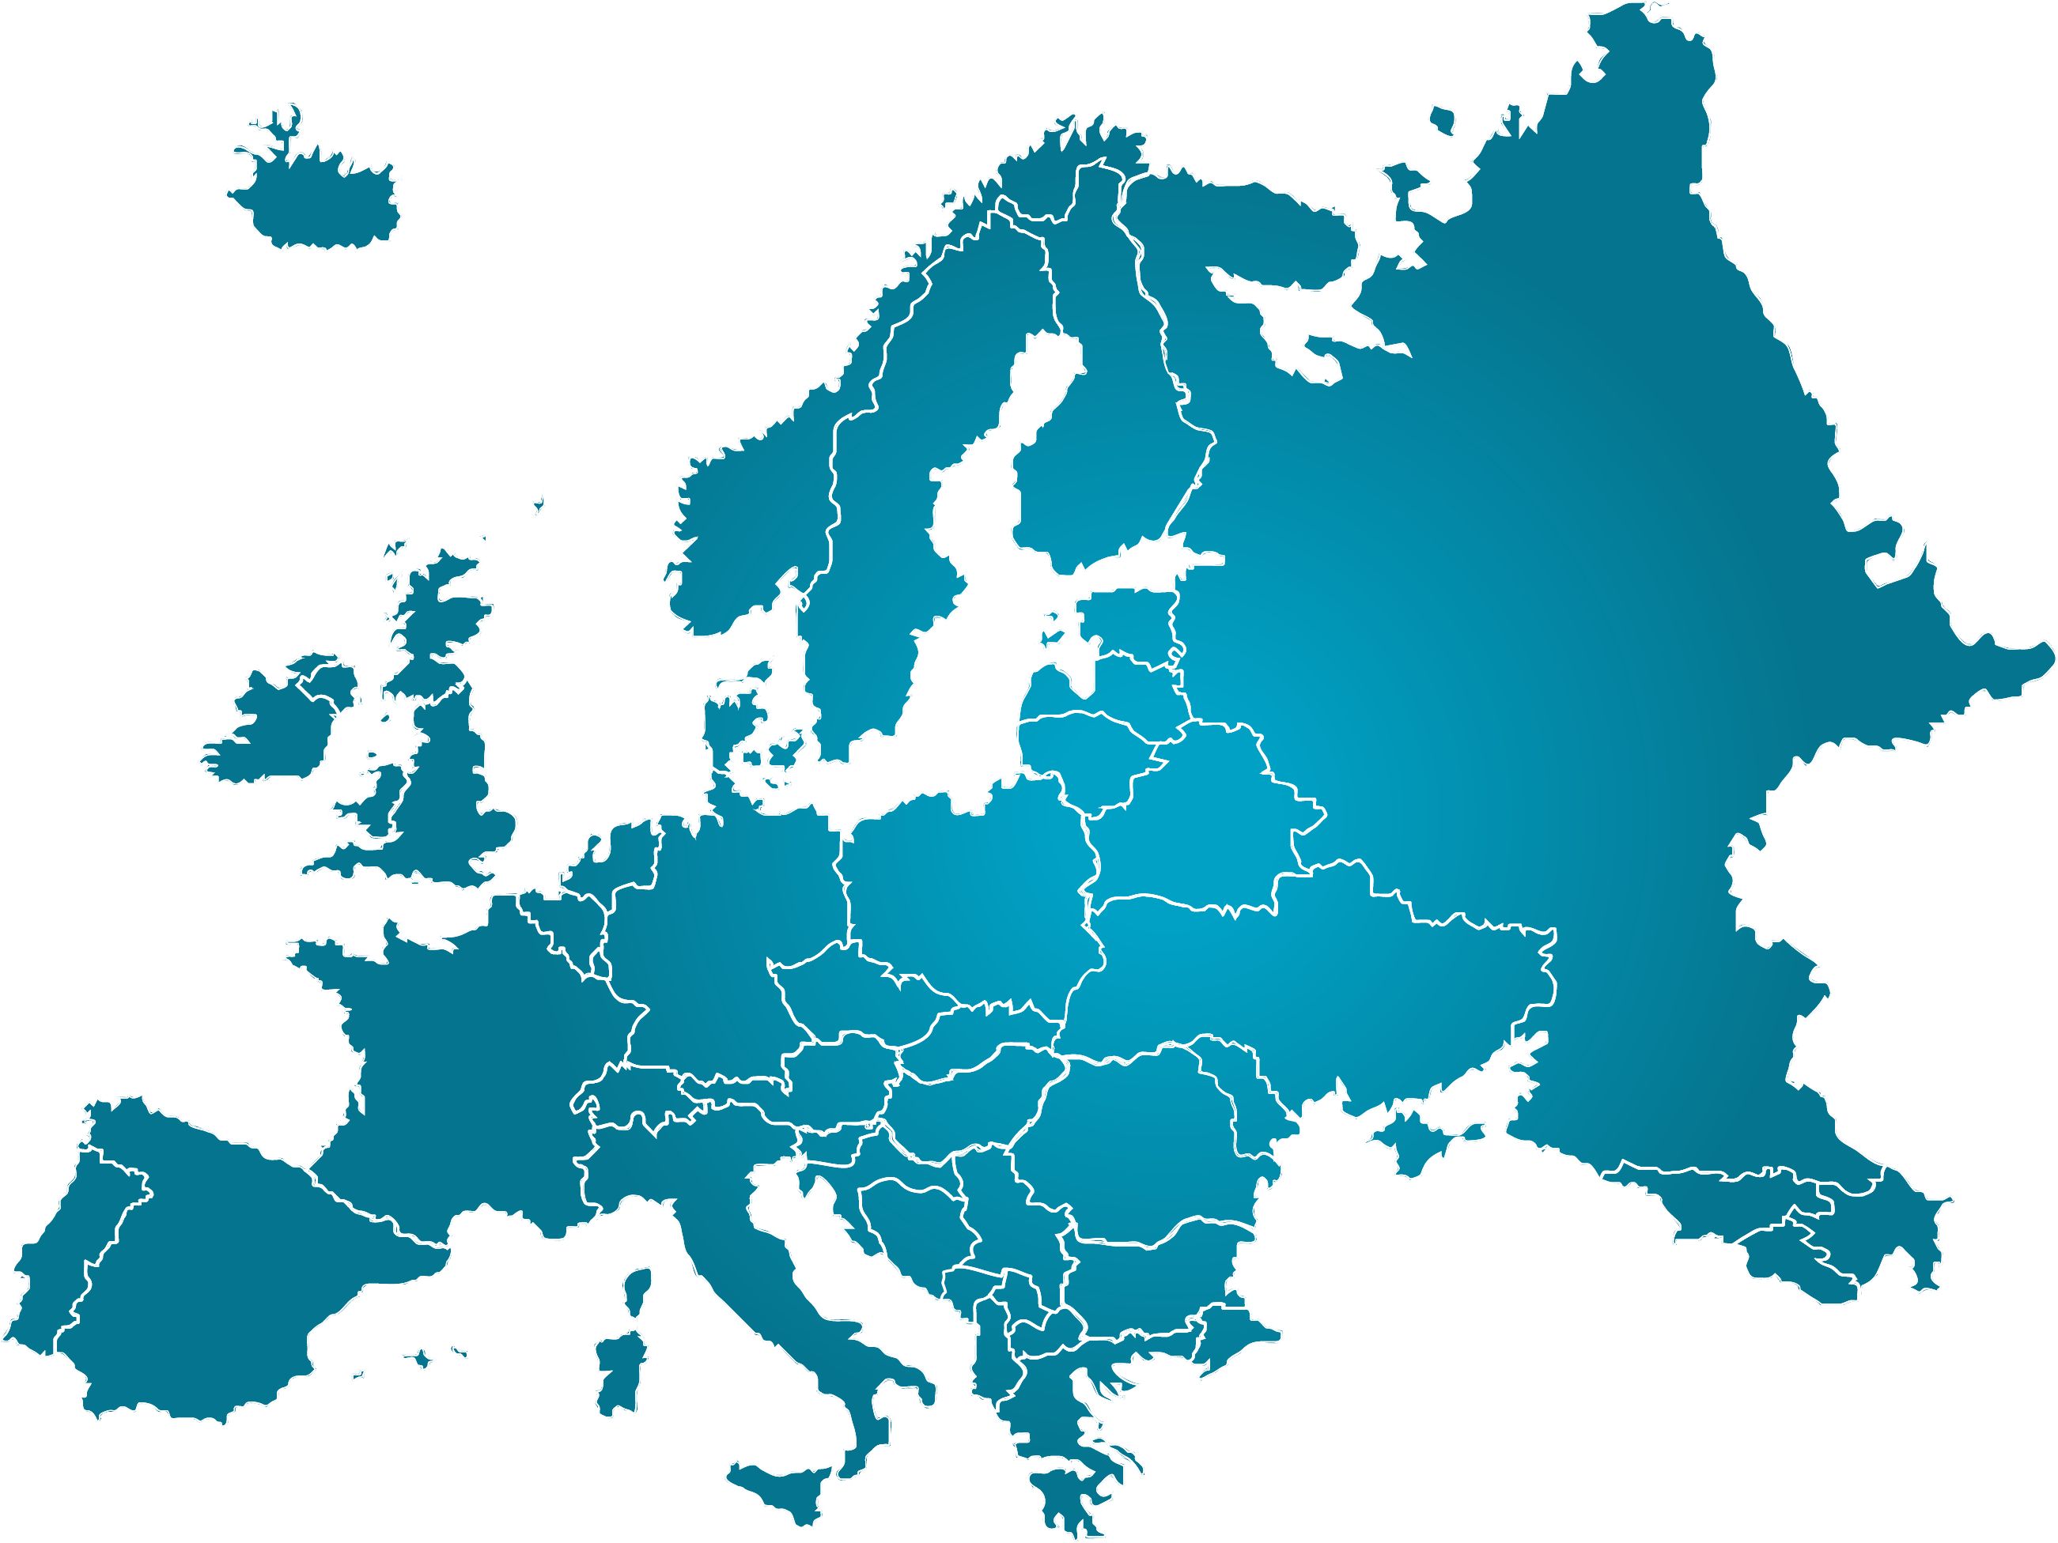
Example: Lists
While on vacation in Europe, I visited several cities: London, Paris, Amsterdam, and Chernobyl.

Slide 60
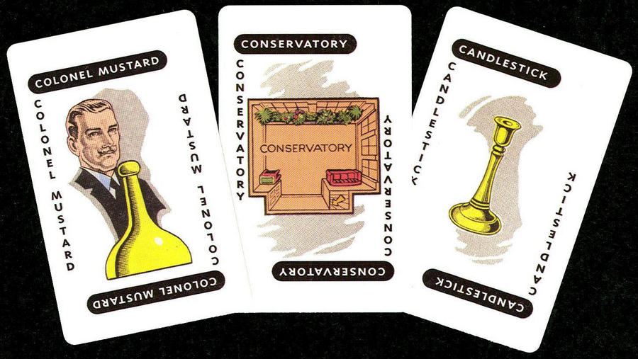
Example: Conclusion
Based on the evidence, it was clear who committed the murder: Colonel Mustard did it in the conservatory with the candle stick!

Slide 61
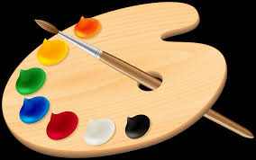
Example: Summation
During paint night, I got paint in my hair, on my hands, and all over my clothes: it was a messy evening.

Slide 62

Should you capitalize the word after the colon?
Some styles, such as APA, do capitalize the first word after a colon if it is a complete sentence.
Do not capitalize for lists!

Slide 63
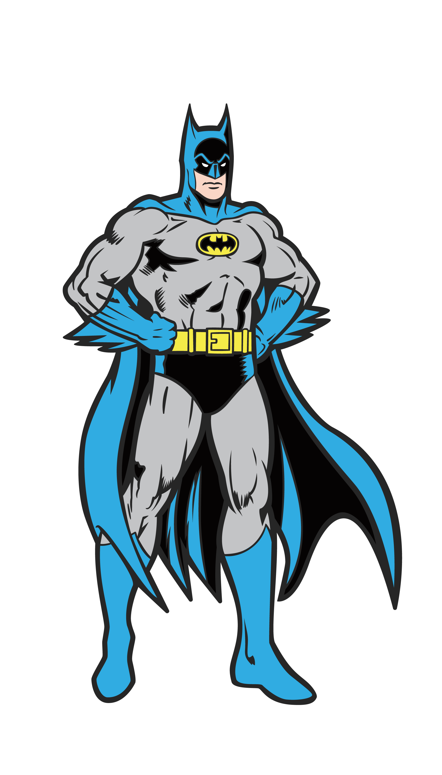
Example: Appositive
I was rescued by Batman: the Dark Knight.

Slide 64
Semicolons

Slide 65
What are Semicolons used for?
Linking two independent clauses.
Separating complex items in a list.

Slide 66
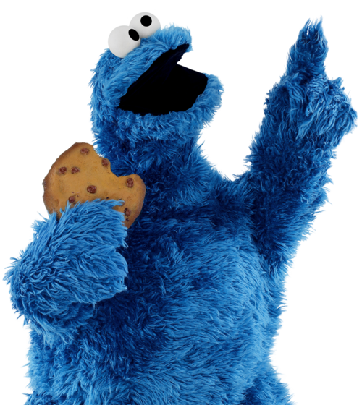
Linking Independent Clauses
There is no flour in my pantry; cookie monster did some baking last night.

Slide 67
The Rules
A semicolon cannot be used with a conjunction.

Slide 68
Explanation
There is no flour in my pantry; cookie monster did some baking last night.
There is no flour in my pantry; because cookie monster did some baking last night.

Slide 69
Simple Item vs. Complex Items
Simple items are either words or short clauses.
Complex items have non-essential information that requires a comma.

Slide 70
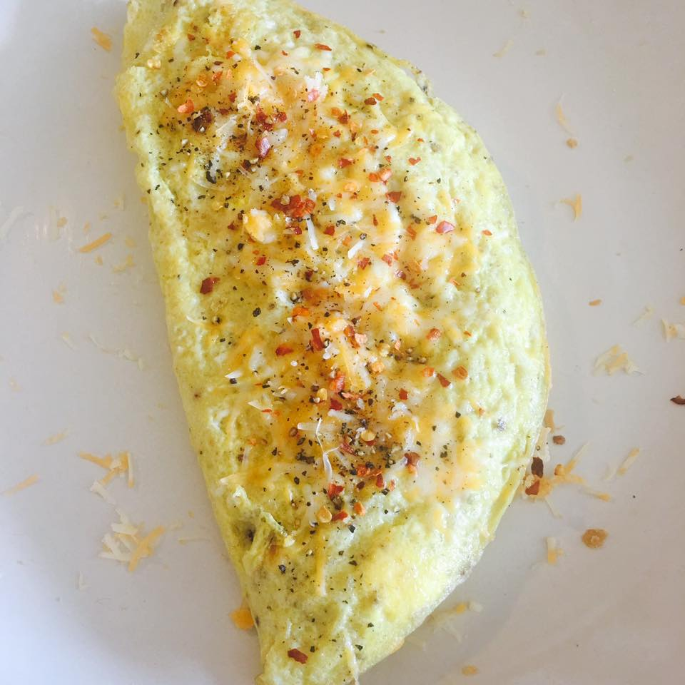
Simple Items
The omelet I made has several ingredients: eggs, broccoli, chicken, and cheese.

Slide 71
Complex Items
The omelet I made has several ingredients: eggs, which I bought at the dairy farm; broccoli, which I grew in my garden; chicken, which I stole from the butcher; and cheese, which I made in my bathroom.

Slide 73
(Parentheses) and [Brackets]

Slide 74
(Parentheses)

Slide 75
Uses for (Parentheses)
Parenthetical Information
In-text Citations

Slide 76
Parenthetical Information: Parentheses or Commas
Parentheses are often seen as informal in this context, so commas are preferred in academic writing.
Parentheses could also be confused with in-text citations if the parenthetical information is a name or date.

Slide 77
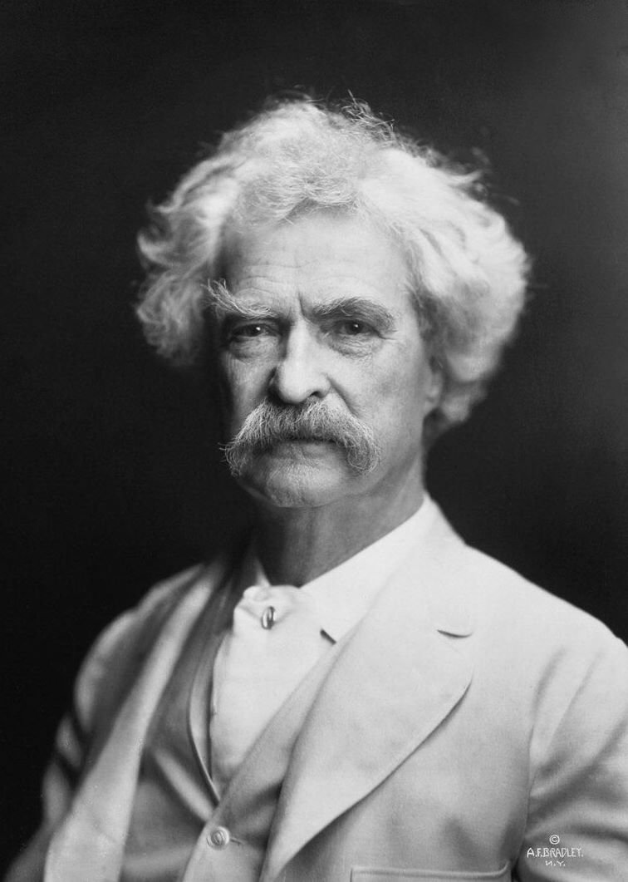
Example: In-Text Citation
Twain (1887) suggest that all one needs is “ignorance and confidence, and then Success is sure” (p. 4).

Slide 78
[Brackets]
Brackets are used exclusively inside quotes.

Slide 79
Uses for [Brackets]
Perspective Shift
Unclear Pronouns
Pejorative Terms

Slide 80
Perspective: Example
In a recent interview, Kanye West said that “rap is the new ballet, and [he is] the greatest ballet dancer of them all”.
NOTE: West says “I am”, which is replaced with [he is].

Slide 81
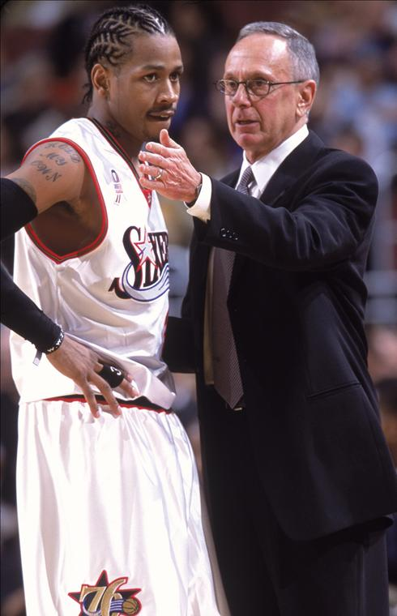
Example Unclear Pronoun
Coach Brown said that, “aside from missing practice, [Iverson] hasn’t been a problem.”
NOTE: When asked about Iverson, Brown referred to him as ‘he’. Out of its original context, it would be unclear who ‘he’ is.

Slide 82
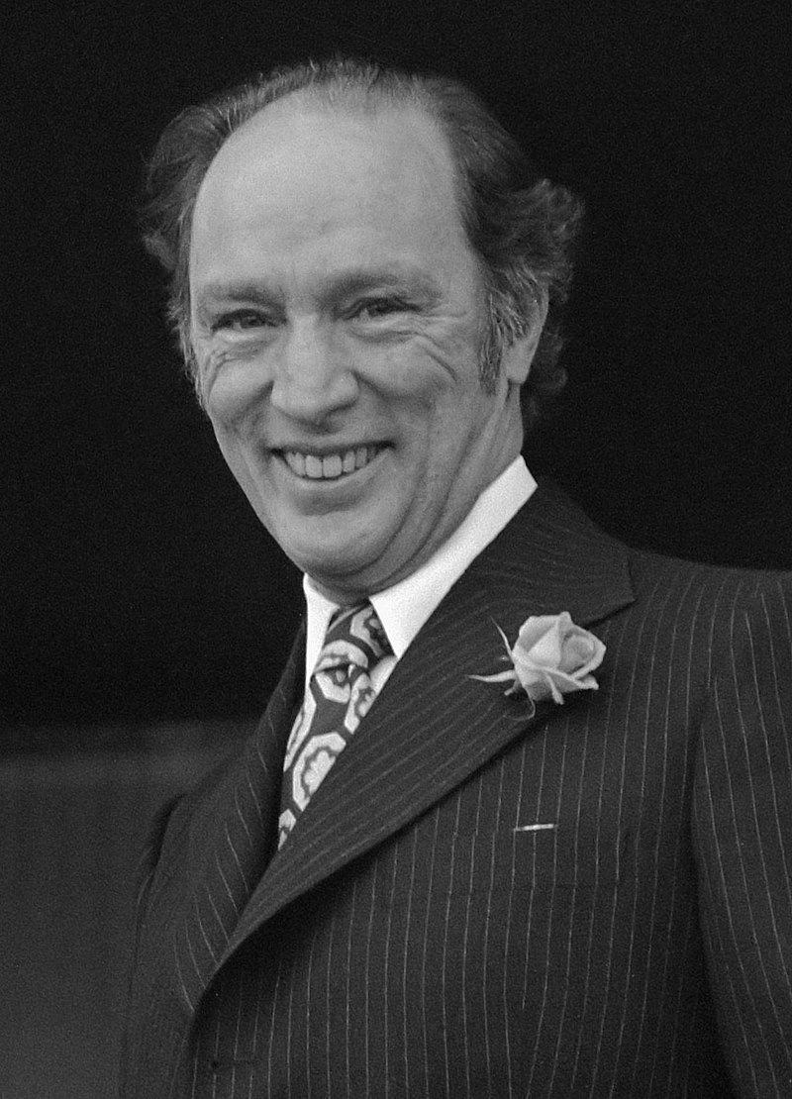
Example: Pejorative Language or Explitives
Former Prime Minister Pierre Trudeau once told a member of parliament to “go [fuddle] his [duddle]”.

Slide 83
Quote Marks: “Double” and ‘Single’

Slide 84
“Double” Quote Marks

Slide 85
“Double” Quote Marks
Direct Quotes
Titles of Short Works

Slide 86
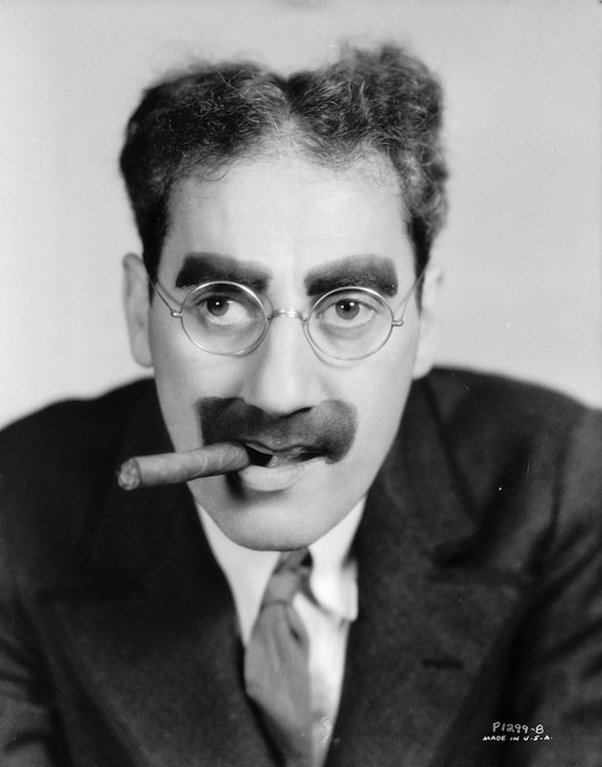
Example: Quote
As Groucho Marx says, “I don't want to belong to any club that will accept people like me as a member.”

Slide 87
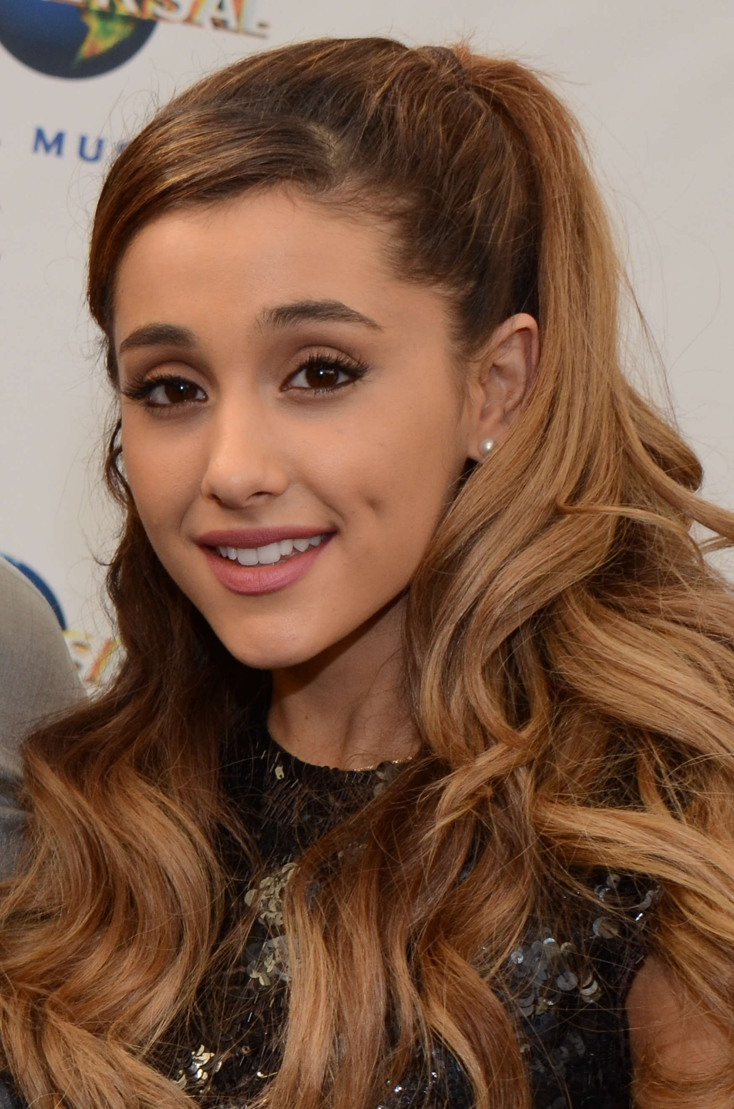
Example: A Short Work
Grande’s (2018) “No Tears Left to Cry” is a metaphysical examination of compassion fatigue.

Slide 88
‘Single’ Quote Marks

Slide 89

Important Note
Double quotes are often used for each of the following.
Check with your instructors for their preferences

Slide 90
‘Single’ Quote Marks
Question Perspectives
Introduce Terms
Discuss Signifiers
Frame Colloquialisms

Slide 91
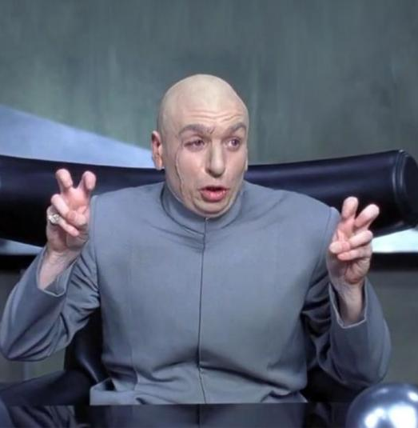
Questioning Perspective
According to research, I’m not ‘normal.’

Slide 92
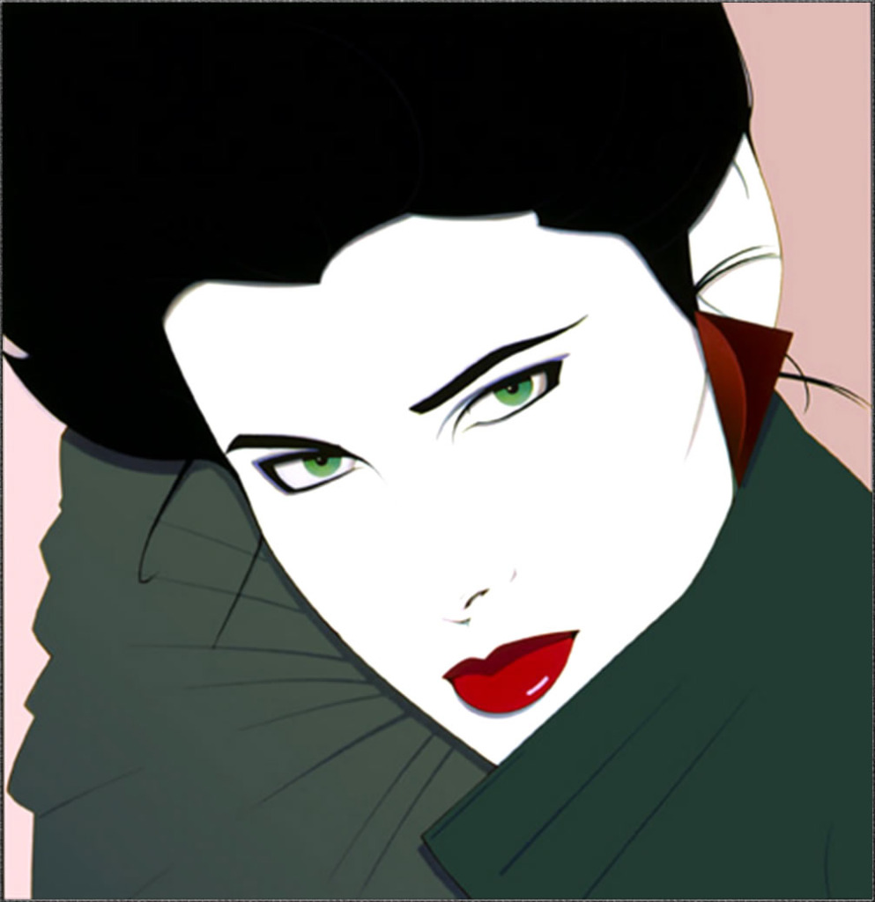
Introducing Terms
In order for your eyebrows by be ‘on fleek,’ they must be systemically and impeccably groomed.

Slide 93
Word as a Signifier
What is a word made up of 4 letters, yet is made up of three. Although is written with 8 letters, then is with 4. Rarely consists of 6 letters, and never is written with 5.

Slide 94
Word as a Signifier
‘What’ is a word made up of 4 letters, ‘yet’ is made up of three. ‘Although’ is written with 8 letters, ‘then’ is with 4. ‘Rarely’ consists of 6 letters, and ‘never’ is written with 5.

Slide 95
Framing Colloquialisms
If double quotes are used to frame a colloquialism, the reader might expect a citation.
NOTE: It is ill-advised to use colloquialisms in your academic writing as they are considered informal.

Slide 96
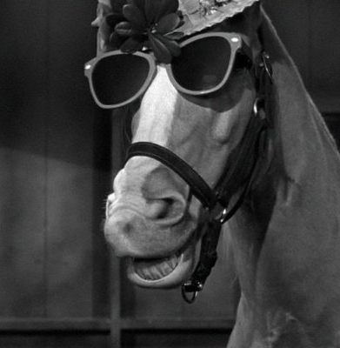
Framing Colloquialisms
As the saying goes, “You should never looked a gift horse in the mouth.”

Slide 97
Italics

Slide 98
‘Single’ Quote Marks
Emphasis
Foreign Languages
Titles of Long Works

Slide 99
Emphasis

Slide 100

Italics for Emphasis?
Using italics to add emphasis for your own words is considered informal or casual.

Slide 101
Examples
I never said she stole my money. = Somebody else said it.
I never said she stole my money. = Emphatically denying he said it.
I never said she stole my money. = Saying he implied it.
I never said she stole my money. = He said somebody else stole it.
I never said she stole my money. = She took, not stole, his money.
I never said she stole my money. = Stole somebody else’s money.
I never said she stole my money. = She stole something else of his.

Slide 102
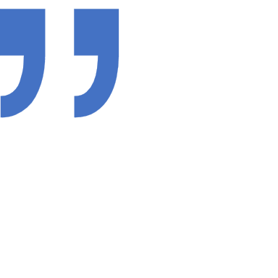
Exception: Quotes
You can italicize a word in a quote as a prelude to your analysis of that word selection.
NOTE: You must note that you have added emphasis in the citation.

Slide 103
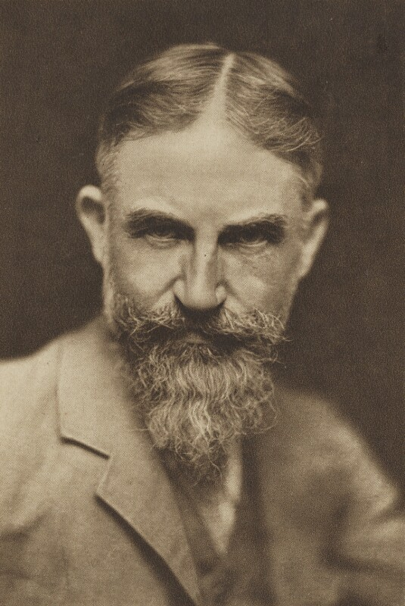
Example
“Life isn’t about finding yourself. Life is about creating yourself” (Shaw, n.d., par. 1, emphasis added).

Slide 104
Foreign Language

Slide 105
Foreign Language
When using a word from a foreign language, such as Latin, French, Klingon, or Ferengi, that word should be put in italics.

Slide 106
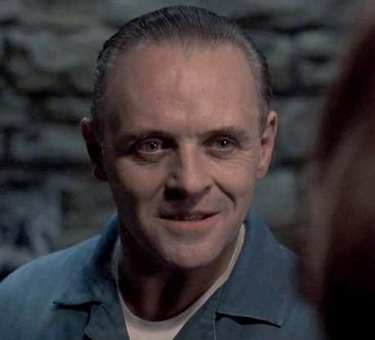
Example
“Quid pro quo. I tell you things; you tell me things.”
Dr. Lecter

Slide 107
Titles of Long Works

Slide 108
Titles of Long Works
When referring to the title of a long work, such as a book or film, these title should be in italics.

Slide 109
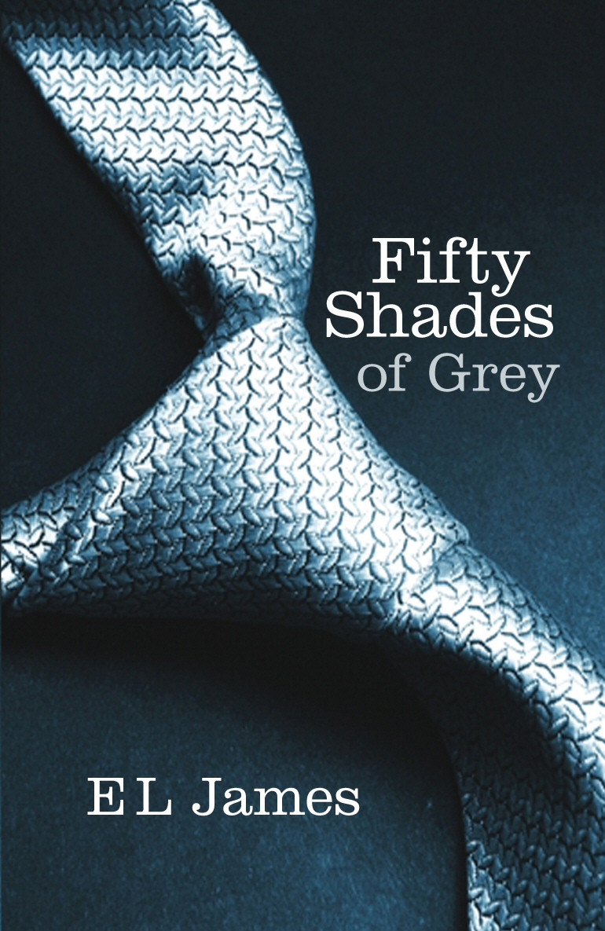
Example
The cover of the novel 50 Shades of Grey is actually printed in fifty shades of blue.

Slide 111

Exercise
The Dear John Letter

Slide 112
